Slide 1
JOURNAL CLUB PRESENTATION
PRESENTERS
Dr Evelyna Gasper
Dr Catherine Kitisho
Dr Emmanuel P

Slide 2
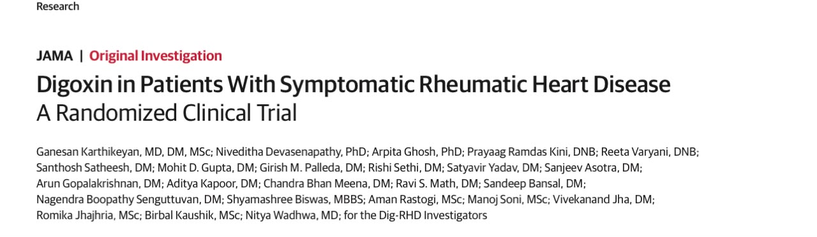
• Published online May 10, 2026
• doi:10.1001/jama.2026.7335

Slide 3
Introduction
RHD is chronic structural and/or functional changes in heart valves caused by one or several episodes of rheumatic fever
It is Multivalvular – 85% Mitral valve, Mixed aortic + mitral disease: 45.4%
The burden is not simply valve anatomy but congestion and arrhythmia
It remains major cause of morbidity in LMICs young adults with most deaths due to heart-failure
Notes:
Peak age 20-29 years

Slide 4
Epidemiology
Globally ~ 55 million people affected by RHD with 360,000 deaths annually
Heart failure is the most common cause of death ~ 1.2 million cases of HF
In Africa, RHD population-based echo prevalence is 18.41 per 1000 ( 1-3%)
Chillo et al 2023 found in a sample of 4436 school children from 4 districts in Tanzania, prevalence of sub-clinical RHD was 2.1%
Notes:
Peak age 20-29 years

Slide 5
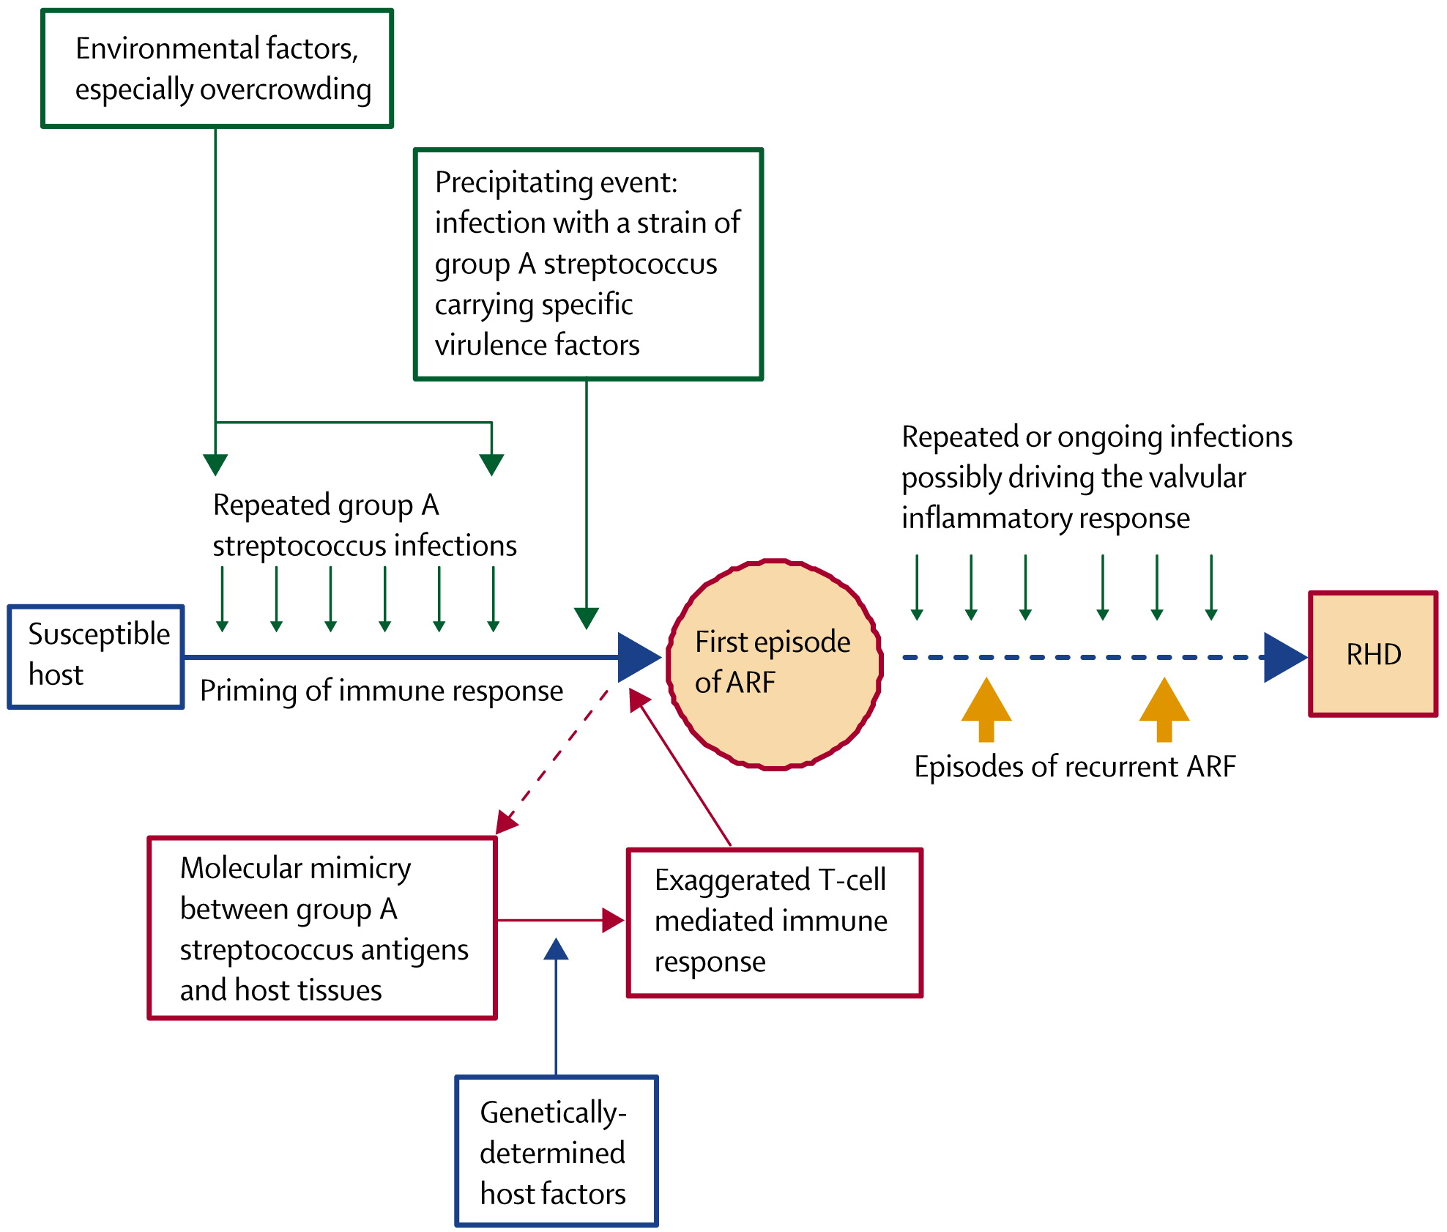
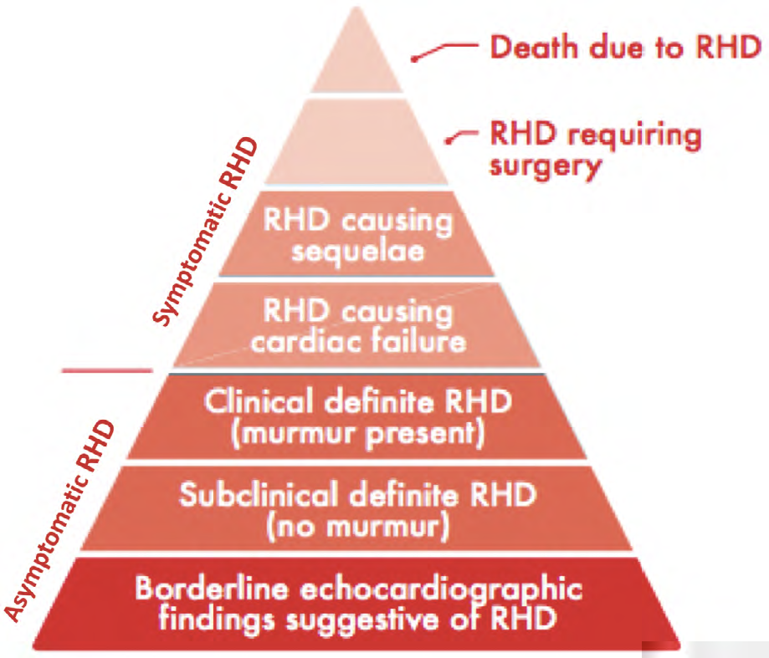
Pathogenesis

Slide 6
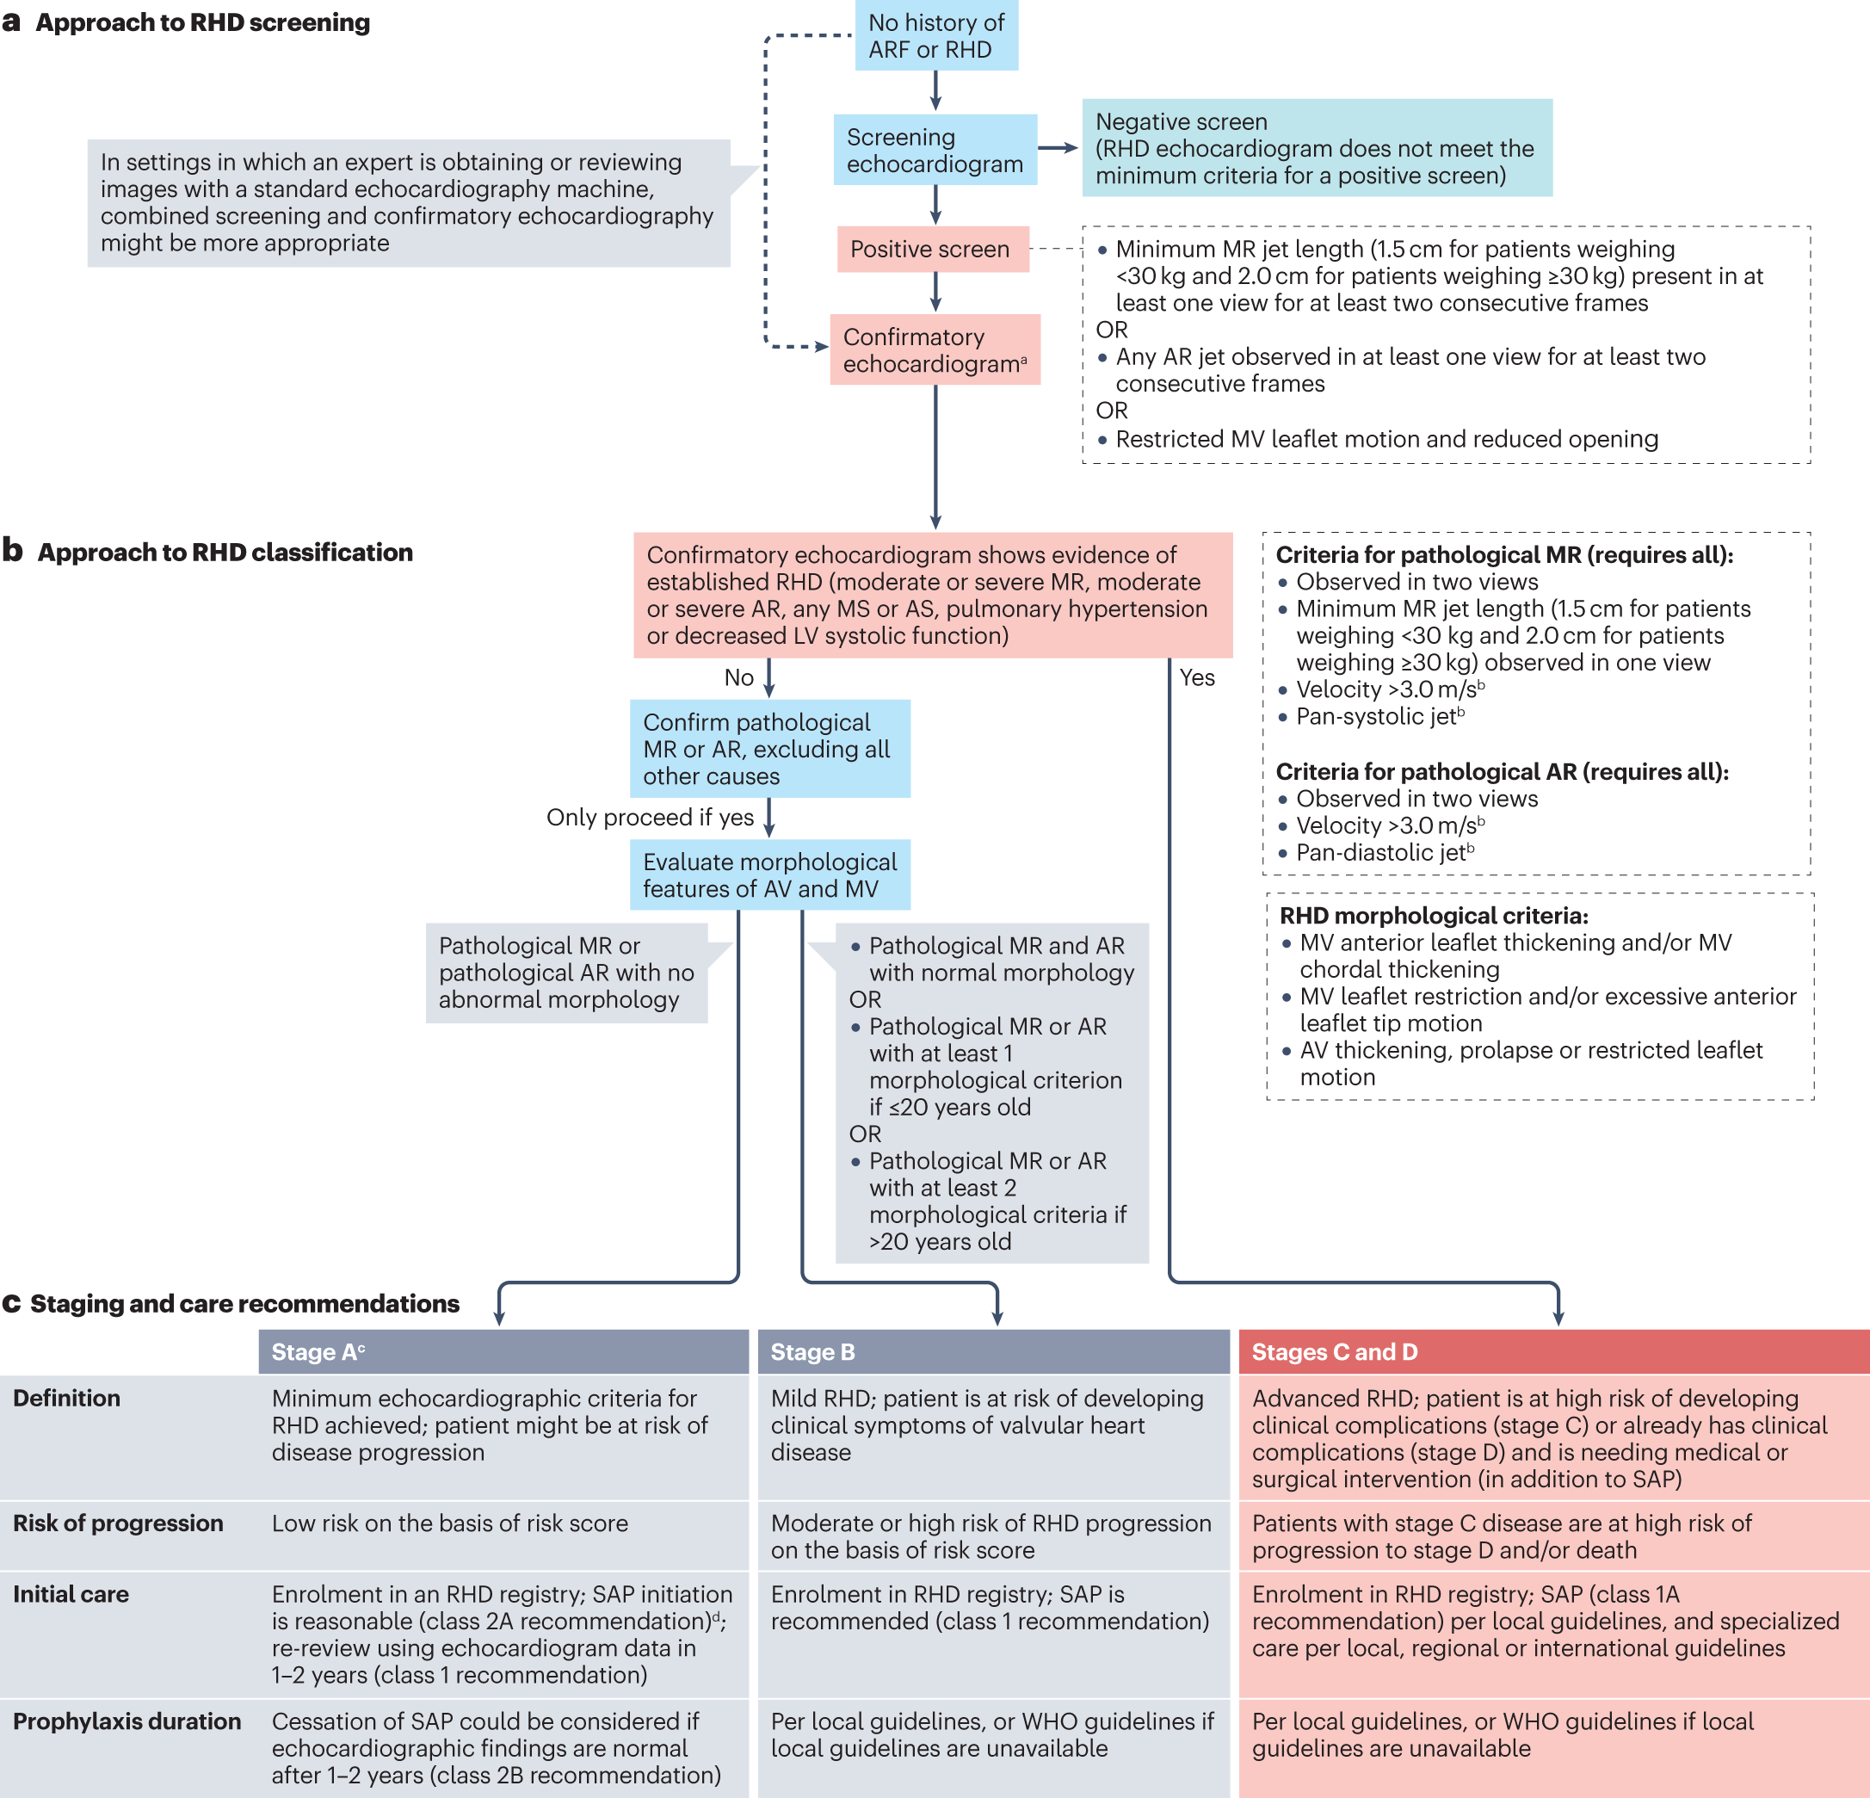
Diagnosis

Slide 7
contd…
Worsening is often triggered by atrial fibrillation/tachycardia, raising left atrial and pulmonary venous pressures
Many symptomatic patients are not immediate candidates for intervention due to surgical risk/resources constrains hence need for medical therapy
Valve lesions
↑ LA pressure
AF / tachycardia
Symptoms
Outcomes
Mitral stenosis/regurgitation ± aortic disease
Pulmonary venous congestion
Shorter filling time; higher LA pressure
Dyspnea, edema, diuretic escalation
HF worsening, admission, death
Notes:
Peak age 20-29 years

Slide 8
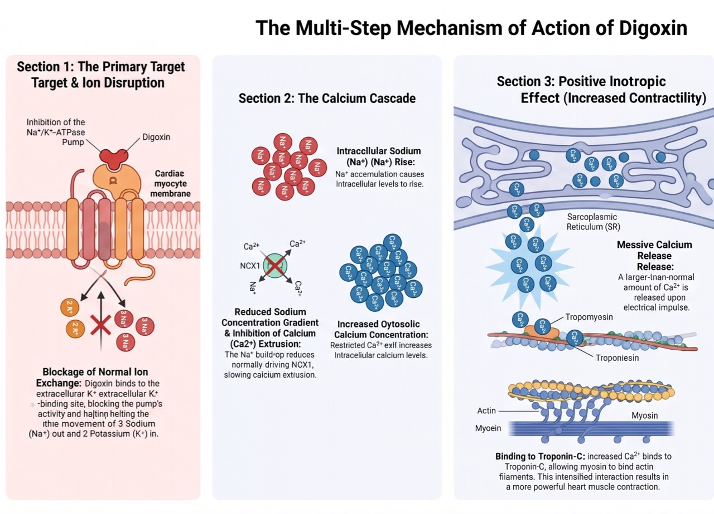
Digoxin: Mechanism

Slide 9
contd…
AV-node effect
Inotropy
Low cost/access
Na⁺/K⁺ ATPase inhibition → higher intracellular Ca²⁺ → modest positive inotropy; relevant for regurgitant lesions or LV dysfunction
Oral, inexpensive medicine; potentially high feasibility in LMIC systems.
Increases vagal tone and slows ventricular response in AF/flutter → longer diastolic filling and lower LA pressure.

Slide 10
Side Effects
Digoxin has a narrow therapeutic index. Most Common Side effect:
  Bradycardia
  Atrioventricular block
  Ventricular Tachycardia
  Nausea
  Vomiting
Notes:
Peak age 20-29 years

Slide 11
LITERATURE REVIEW

Slide 12
)
STUDY | YEAR | METHOLOGY | RESULTS | GAPS
DIG Trial, The Effects of digoxin on Mortality and Morbidity in patient with heart failure | 1997 Multicentre (USA & Canada) | Phase 3 trial, Randomized, double blind, placebo – controlled Multicentre trial, (USA & Canada) (37 months) N= 6800 with Chronic HF, LVEF< 45%, sinus rhythm | Digoxin has no Mortality benefit RR 0.99, 95% CI 0.91-1.07, P= 0.8 Digoxin reduced HF Hospitalization RR 0.72, 95% CI 0.66- 0.79, P=0.001 | Older(Mean age 64) ischemic/comorbid population Not RHD -specific
Increased Mortality among patients taking digoxin Whitbeck et al | May 2013 | Post hoc observation analysis within a Multicenter AF trial Assessed association between digoxin use and Mortality in AF N= 4060 | Digoxin associated -with higher all-cause mortality HR 1.41 95% CI 1.19-1.67 Higher Cardiovascular mortality P=0.016 | Not randomized- Confounding by indication Non RHD - specific

Slide 13
STUDY | YEAR | METHODOLOGY | RESULTS | GAPS
Global RHD Registry/ REMEDY Digoxin analysis Karthikeyan et al | 2019 | Observation analysis of digoxin use in RHD from the REMEDY registry N = 3298 Assessed 2-year mortality, recurrent HF and hospitalization | Digoxin was associated with mortality OR 1.63 Recurrent HF OR 1.48, P = 0.019 | Observational study Strong confounding by indication
RATE- AF Trial | 2020 | Phase 3 trial, Randomized, open-label, blinded- endpoint placebo – controlled Multicentre trial, (USA & Canada) (37 months) N= 6800 Chronic HF, LVEF< 45%, sinus rhythm | Digoxin was associated with mortality OR 1.63 Recurrent HF OR 1.48, P = 0.019 | Observational study Strong confounding by indication
Notes:
REMEDY- Used Multivariable and propensity weighed analyses
N 3298 with baseline digoxin

Slide 14
Problem Statement
RHD causes high morbidity and Mortality largely due to Heart failure
Digoxin is biologically plausible, widely available, already used by clinician
Prior data in RHD shows increased mortality but were observational and vulnerable to confounding by indication
No randomized trial evidence establishing its efficacy and safety of Digoxin for patient with RHD

Slide 15
Rationale
RHD patients have complex multivalve disease – Not always candidates for surgery and may rely on medical management
Patient with RHD a younger with fewer comorbidities – they might have a more favorable risk benefit profile
  Hence, this trial was designed to evaluate whether digoxin can reduce risk of death or new-onset heart failure or worsening heart failure among patients with symptomatic RHD

Slide 16
Broad Objective
To determine whether digoxin therapy when compared to placebo (on a background of standard care) improves a composite outcome of all cause death and new onset or worsening HF in patient with symptomatic rheumatic heart disease

Slide 17
Specific Objectives
To determine digoxin’s effect of on a composite of all-cause death or new-onset or worsening HF within 36 months follow-up or until study end
To determine effect of digoxin on all-cause death
To determine effect of digoxin on death due to HF
To determine effect of digoxin on new-onset or worsening heart failure
To monitor safety profile of digoxin

